Slide 1
Multi-Cluster AwarE SDK Overview
Bruno Guedes – Sales Engineer – bruno.guedes@couchbase.com

Slide 2
AGENDA
01/
MCA SDK Motivations
02/
Application Considerations
03/
Features and Functionality
04/
Use Case Review
05/
Define MCA SDK Configuration
06/
Define Success Criteria

Slide 3
MCA SDK Motivations
1

Slide 4
Objectives
Provide ultra-high application availability.
Address failure conditions that Couchbase Server cannot.

Slide 5
Server-side high availability features
Configurable replication levels
Replica anti-affinity
Rack/Zone awareness
Auto-failover
Replica reads
Supports loss of nodes or zones up to configured replica count
Can trade consistency for high availability reads during failure

Slide 6
Server-side limitations
Local cluster availability limited by replica count
Write latency during failure depends on auto-failover timeout
Cannot address failures between client and server

Slide 7
Solution
Server-side:
Use XDCR to provide low latency active/active replication.
Client-side:
Implement local fault detectors
Expose API for defining failure conditions
Provide rule-based automated failure coordination
Provide facilities for failback

Slide 8
Application Considerations
2

Slide 9
Application considerations
XDCR is asynchronous and provides eventual consistency between clusters.
Couchbase does not provide write-time XDCR replication guarantees.
Active/active XDCR can result in point-in-time inconsistency and conflicts.
Couchbase will resolve conflicts using last-write-wins semantics.
For some applications, conflict resolution can result in data loss.

Slide 10
Risk factors for inconsistency and conflict
Inconsistencies are observed in applications that have:
Multi-document entity models when some documents are not replicated.
“Read Your Own Write” requirements when reads/writes are split between clusters.
Conflicts occur when applications write to the same document across clusters before replication takes place.

Slide 11
Limiting inconsistency and conflict
Denormalize logical entities to a single document. This allows all dependents to be replicated atomically.
When entities cannot be fully denormalized, collocate data that is frequently read and written together. Focus on the relationships that require consistency.
Sessions should be “sticky” to one data center at a time.
Failover reads and writes concurrently.
Ensure replication is caught up before initiating failback.

Slide 12
Features and Functionality
3

Slide 13
Components
Coordinator: defines when and how to to failover
Failure Detectors: track faults and send failure signals to coordinator
Multi Cluster Client: abstracts the base SDK to implement MCA functionality
TopologyAdmin: provides interfaces for directly effecting failover/failback

Slide 14
Coordinators
Responsible for communicating topology changes and related events between distinct instances of the client.
Only IsolatedCoordinator is currently supported.
Each instance considers itself the “leader”
Each instance will failover independently

Slide 15
ClusterSpec instantiation
ClusterSpec cluster1 = ClusterSpec.create( new HashSet<String>(Collections.singletonList("10.142.170.101")), 1 // priority of one, lower than cluster 2 );
ClusterSpec cluster2 = ClusterSpec.create( new HashSet<String>(Collections.singletonList("10.142.170.103")), "identifier", 2 // priority of two, higher than cluster 1 );

Slide 16
Coordinator instantiation
Coordinator coordinator = Coordinators.isolated(new IsolatedCoordinator.Options() .gracePeriod(1000) .activeEntries(2) .clusterSpecs(Arrays.asList(cluster1, cluster2)) .failoverNumNodes(2));

Slide 17
Coordinator Options
Option | Default | Description
clusterSpecs | 1 spec to 127.0.0.1 | Needs references to all clusters which should be managed by this coordinator.
gracePeriod | 0 | The time in milliseconds to wait after a failure signal is triggered before the switchover is performed.
topologyBehavior | STAY_AT_END | What should happen if the end of the topology is reached and a switchover needs to happen. See the TopologyBehavior enum for more information as well.
activeEntries | 1 | The maximum number of active topology entries at the same time.
serviceTypes | BINARY | Defines which services should be allowed for each topology entry.
failoverNumNodes | 1 | The number of individual node failures in a cluster before the full topology failover is performed.

Slide 18
Failure Detectors
A FailureDetector is responsible for monitoring events like cluster activity or data traffic, and to signal failure to the Coordinator when a failure threshold is triggered.
There are 2 basic types of FailureDetectors:
NodeHealthFailureDetector
TrafficMonitoringFailureDetector
FailureDetectors can be composed to describe composite failure conditions.
DisjunctionFailureDetector: logical OR for inner FailureDetectors
ConjunctionFailureDetector: logical AND for inner FailureDetectors

Slide 19
Failure Detectors
import com.couchbase.client.mc.detection.*;
TrafficMonitoringFailureDetector.Options options = TrafficMonitoringFailureDetector.options()
.maxFailedOperations(5)
.failureInterval(60);
FailureDetectorFactory detector = FailureDetectors.trafficMonitoring(coordinator, options);

Slide 20
NodeHealthFailureDetector
Option | Default | Description
configCheckInterval | 5000 | The interval when the config is checked for ongoing rebalance.
rebalanceOutGracePeriod | 15000 | The period after a rebalance when node removals are still ignored.

Slide 21
TrafficMonitoringFailureDetector
Option | Default | Description
maxFailedOperations | 5 | the number of failed operations before failure is signaled.
failureInterval | 60000 | the interval in which the failed ops are counted.
serviceScope | empty (all) | all the services which should be monitored.
exceptionScope | TimeoutException, RequestCancelledException | all the exceptions which are counted towards failure.
nodeScope | false | true if the failed ops are counted globally per cluster on a per node basis.

Slide 22
The Multi Cluster Client
Abstracts the base SDK in order to provide MCA functionality.
MultiClusterClient client = new MultiClusterClient(coordinator, detector); client.authenticate("username", "password"); MultiClusterBucket bucket = client.openBucket("travel-sample");
bucket.get("airline_10", 2, TimeUnit.SECONDS);
Observable<JsonDocument> result = bucket.async().get("airline_10", 1, TimeUnit.SECONDS);

Slide 23
Topology Administration
TopologyAdmin allows manual changes the current cluster topology entries. This can be used to trigger a failover/failback.
There are currently two admin classes:
SimpleTopologyAdmin: Provides simple programmatic access to the topology.
JmxTopologyAdmin: Builds on top of the SimpleTopologyAdmin and exposes some of the functionality through a JMX MxBean.

Slide 24
Programmatic Access
activate(TopologyEntry): Activates the given entry in the current topology.
activate(String): Looks up a topology entry by the identifier and activates it.
deactivate(TopologyEntry): Deactivates the entry in the current topology.
deactivate(String): Looks up a topology entry by the identifier and deactivates it.
fail(TopologyEntry): Shifts the whole topology away to the next possible entry according to set priority.
fail(String): Looks up the entry by the identifier and then fails it.

Slide 25
SimpleTopologyAdmin Example
List<ClusterSpec> clusterSpecs = createSpecs(); Coordinator coordinator = Coordinators.isolated(new IsolatedCoordinator.Options() .clusterSpecs(clusterSpecs) );
SimpleTopologyAdmin admin = SimpleTopologyAdmin.create(coordinator); Topology topology = admin.currentTopology(); // Fetch the current topology topology.deactivate("cluster-1"); // Deactivate an entry topology.activate("cluster-2"); // Activate another entry admin.commitTopology(topology) // try to apply the new topology

Slide 26
JMXTopologyAdmin
It is possible to get information about the current topology state as well as change it via JMX (Java Management Extensions).
Initializing is easy, just pass in the right Coordinator.
JmxTopologyAdmin admin = JmxTopologyAdmin.create(coordinator);
You can then access the topology information via a JMX client/console like Java Mission Control, JConsole or VisualVM.

Slide 27
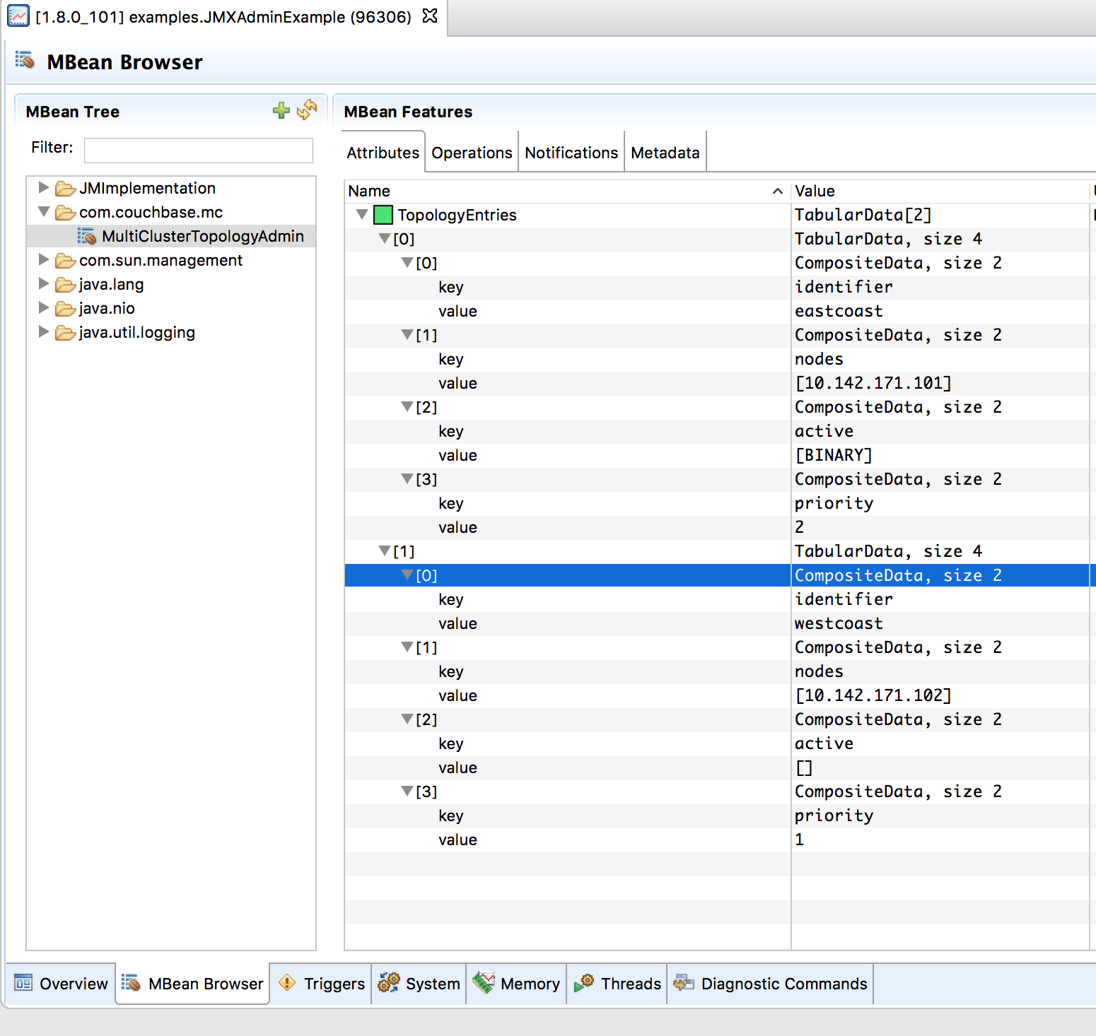
JMX Attributes

Slide 28
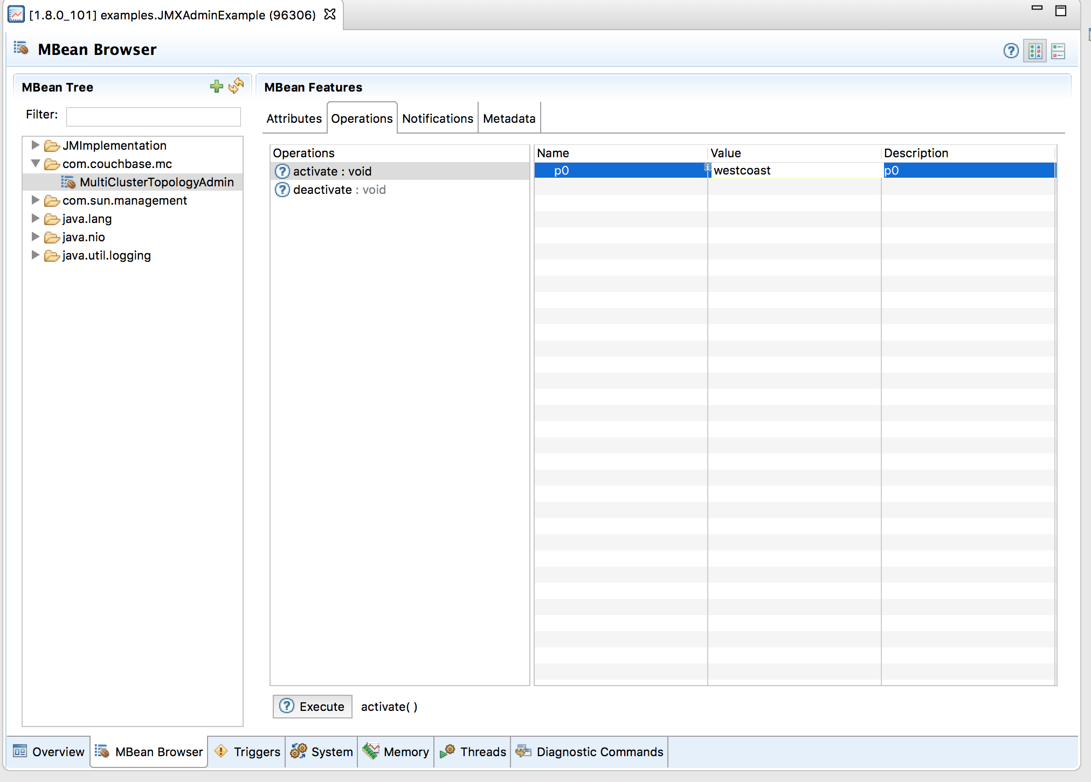
JMX Operation

Slide 29
Use Case Review
4

Slide 30
Define MCA SDK Configuration
5

Slide 31
Add the MCA SDK to your application
Work with Couchbase to obtain credentials for subscription.couchbase.com
Add repository credentials to maven: ~/.m2/settings.xml:
<settings> <servers> <server> <id>cb-ee</id> <username>myUsername</username> <password>myPassword</password> </server> </servers> </settings>

Slide 32
Add the MCA SDK to your application
Add the repository and dependency to your pom.xml:
<repositories> <repository> <id>cb-ee</id> <name>Couchbase EE Repo</name> <url>https://subscription.couchbase.com/maven2</url> </repository> </repositories> <dependencies> <dependency> <groupId>com.couchbase.client</groupId> <artifactId>multi-cluster-java</artifactId> <version>1.2.0</version> </dependency> </dependencies>

Slide 33
Update the application
Define a ClusterSpec for each application
Define your FailureDetectors and failure thresholds
Define a Coordinator and coordinator options
Replace cluster and bucket objects with the MultiClusterClient
Update all bucket methods to include explicit operation timeouts

Slide 34
DEFINE SUCCESS CRITERIA
6

Slide 35
Demo
7

Slide 36
Requirements
Java installed
Docker installed
Maven installed

Slide 37
Framework used
Spring (Boot-Data used)
Couchbase Java SDK
Couchbase MCA

Slide 38
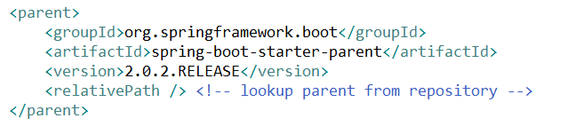

Dependencies
Spring (Boot-Data used)
Couchbase Java SDK
Couchbase MCA

Slide 39
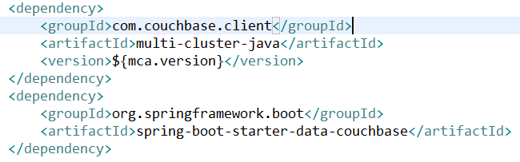
Dependencies
Spring (Boot-Data used)
Couchbase Java SDK
Couchbase MCA

Slide 40



Architecture
DC1
DC2
Data
Data
Server1 – 172.17.0.2
Server1 – 172.17.0.3
Server1 – 172.17.0.4
Query
Query
Server1 – 172.17.0.5
Server2 – 172.17.0.6
Server3 – 172.17.0.7
GSI
GSI
Couchbase Cluster
Couchbase Cluster
GET http://localhost:8080/api/airports/airport/airport_1254/
bucket.get(airport_1254)
Couchbase SDK
MCA

Slide 41
Architecture – Failure of a Node in DC1 (KV)
DC1
DC2
Docker stop server2
Data
Data
Server1 – 172.17.0.2
Server1 – 172.17.0.3
Server1 – 172.17.0.4
Query
Query
Server1 – 172.17.0.5
Server2 – 172.17.0.6
Server3 – 172.17.0.7
GSI
GSI
Couchbase Cluster
Couchbase Cluster
GET http://localhost:8080/api/airports/airport/airport_1254/
bucket.get(airport_1254)
Couchbase SDK
MCA

Slide 42
Architecture – REST request switch to the other DC2
DC1
DC2
Data
Data
Server1 – 172.17.0.2
Server1 – 172.17.0.3
Server1 – 172.17.0.4
Query
Query
Server1 – 172.17.0.5
Server2 – 172.17.0.6
Server3 – 172.17.0.7
GSI
GSI
Couchbase Cluster
Couchbase Cluster
GET http://localhost:8080/api/airports/airport/airport_1254/
bucket.get(airport_1254)
Couchbase SDK
MCA

Slide 43
Architecture – Bring back the node failed on DC1
DC1
DC2
Docker start server2
Data
Data
Server1 – 172.17.0.2
Server1 – 172.17.0.3
Server1 – 172.17.0.4
Query
Query
Server1 – 172.17.0.5
Server2 – 172.17.0.6
Server3 – 172.17.0.7
GSI
GSI
Couchbase Cluster
Couchbase Cluster
GET http://localhost:8080/api/airports/airport/airport_1254/
bucket.get(airport_1254)
Couchbase SDK
MCA

Slide 44
Architecture - Failure of a Node in DC2 (KV)
DC1
DC2
Docker stop server2
Data
Data
Server1 – 172.17.0.2
Server1 – 172.17.0.3
Server1 – 172.17.0.4
Query
Query
Server1 – 172.17.0.5
Server2 – 172.17.0.6
Server3 – 172.17.0.7
GSI
GSI
Couchbase Cluster
Couchbase Cluster
GET http://localhost:8080/api/airports/airport/airport_1254/
bucket.get(airport_1254)
Couchbase SDK
MCA

Slide 45
Architecture – REST Failure
DC1
DC2
Data
Data
Server1 – 172.17.0.2
Server1 – 172.17.0.3
Server1 – 172.17.0.4
Query
Query
Server1 – 172.17.0.5
Server2 – 172.17.0.6
Server3 – 172.17.0.7
GSI
GSI
Couchbase Cluster
Couchbase Cluster
GET http://localhost:8080/api/airports/airport/airport_1254/
bucket.get(airport_1254)
Couchbase SDK
MCA

Slide 46
Architecture – Bring to DC1
DC1
DC2
Data
Data
Server1 – 172.17.0.2
Server1 – 172.17.0.3
Server1 – 172.17.0.4
Query
Query
Server1 – 172.17.0.5
Server2 – 172.17.0.6
Server3 – 172.17.0.7
GSI
GSI
Couchbase Cluster
Couchbase Cluster
GET http://localhost:8080/api/airports/airport/airport_1254/
bucket.get(airport_1254)
Couchbase SDK
MCA

